Slide 1
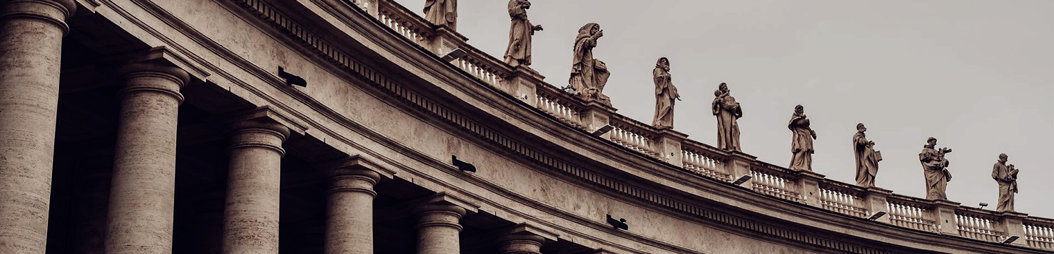
CIFAR-10 Image Classifier with PyTorch & Streamlit
Implemented by Blaine Swieder

Slide 2
Motivation & Goals
Motivation: Reviewing Deep Learning
Goal 1: Build an end-to-end ML app that classifies images into 10 classes (airplane to truck).
Goal 2: Gain practical experience deploying a model, not solely training it.
Goal 3: Gain an internship, hence experience.
Tools: Python 3.10, PyTorch, Streamlit, Convolutional Neural Network (CNN).

Slide 3
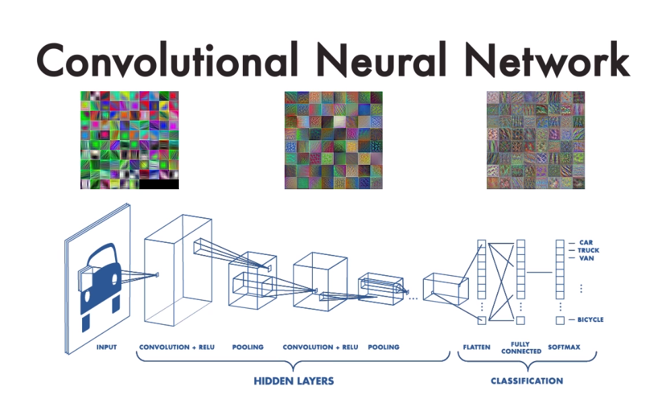
What is a CNN?
A Convolutional Neural Network (CNN) is a deep learning model that specializes in recognizing patterns in visual data
A CNN has applications in everything from image classification and medical scans to self-driving cars and surveillance systems.

Slide 4
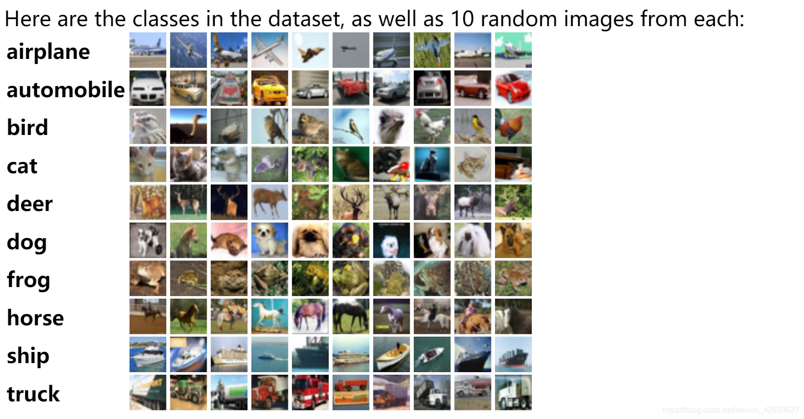
CIFAR-10 Dataset Overview
CIFAR-10 is 60,000 32×32 images across 10 classes.
Split into 50,000 training and 10,000 test images.
All uploaded images are resized to 32×32
Images normalized to mean 0.5, std 0.5

Slide 5
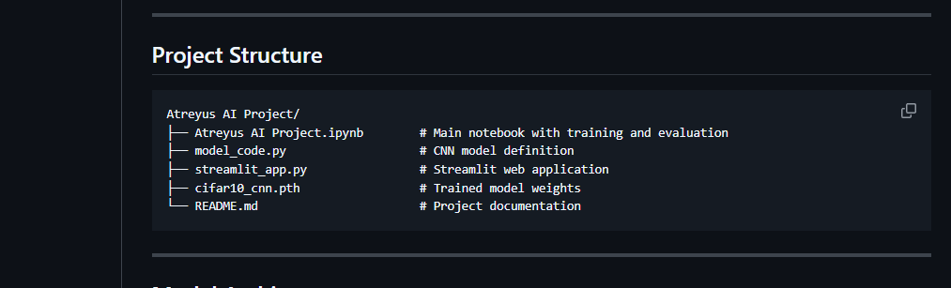
Project Overview

Slide 6
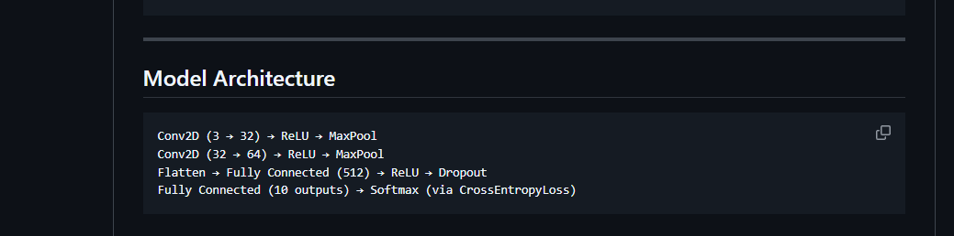
Model Design: Simple CNN
Lightweight, fast to train.
Sufficient depth for CIFAR-10.
Dropout to reduce overfitting.

Slide 7
Training Process
Training Process: PyTorch (Framework), 5 Epochs, Adam Optimizer, Cross Entropy Loss (Loss Function), Accuracy and Loss (Metrics tracked).
The training loop consists of a forward pass, compute loss, backpropagation, and optimizer step.
Accuracy tracked at the end of each epoch.
Achieved 82.90% accuracy at the end of Epoch 5.

Slide 8
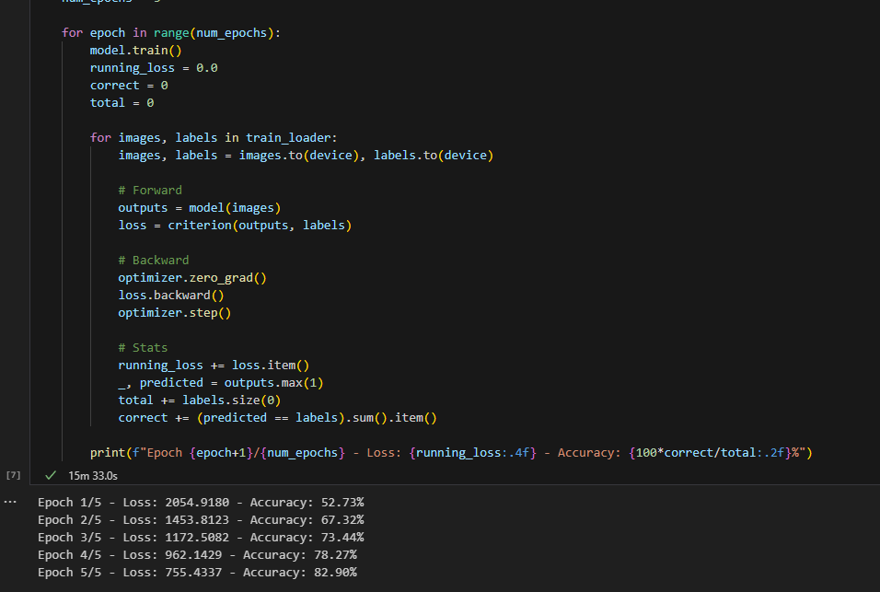
Training Process

Slide 9
Live Demo: Web App with Streamlit
User uploads an image.
App resizes to 32x32 and feeds into model.
Will return Top-3 class predictions with confidence.
Works well with images such as classes.
Struggles where image is more complex.

Slide 10
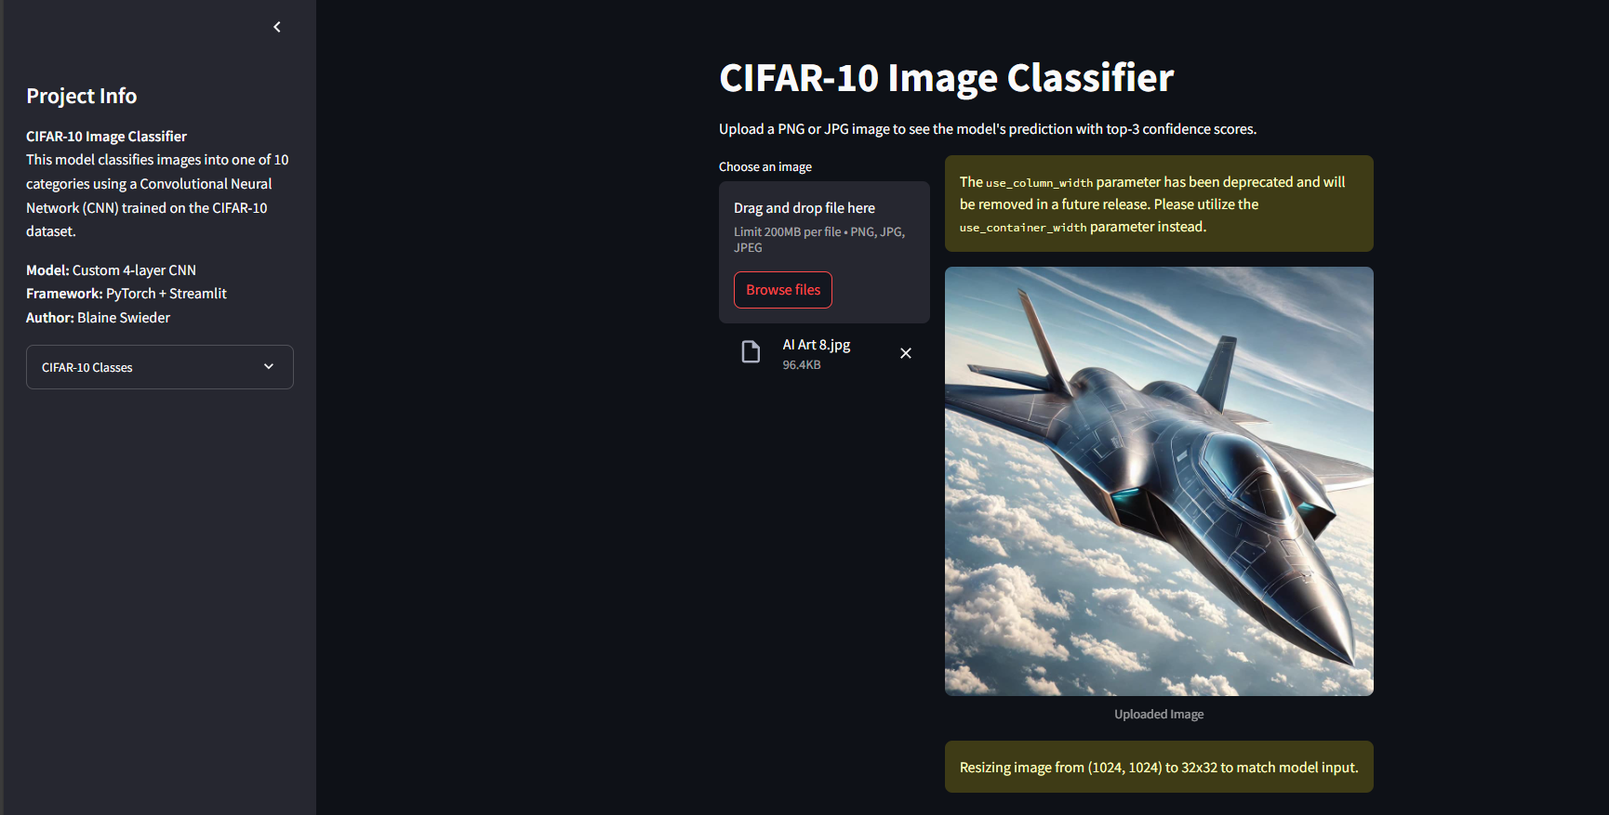
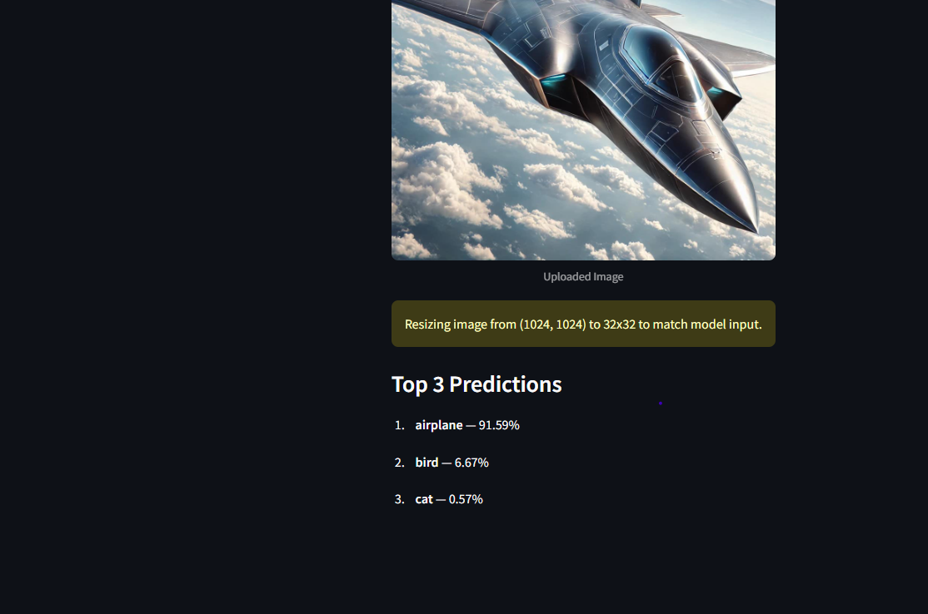
Streamlit Example

Slide 11
Challenges & Future Work
Small Image size limit details.
Resizing may distort inputs.
No augmentation yet.
Potential Improvements: Use ResNet, Expand to CIFAR-100 for more classes, and Improve UI aesthetics and robustness.

Slide 12
Q & A
Thank you for listening!
The project is available on my GitHub.

